Slide 1
I Am a CAT
Yuan Yuan 22015680
Weekly Blog Link: https://github.com/22015680/Physical_Computing_Final/blob/main/README.md
Video Link: https://www.youtube.com/watch?v=x8YfwxpP5kw

Slide 2
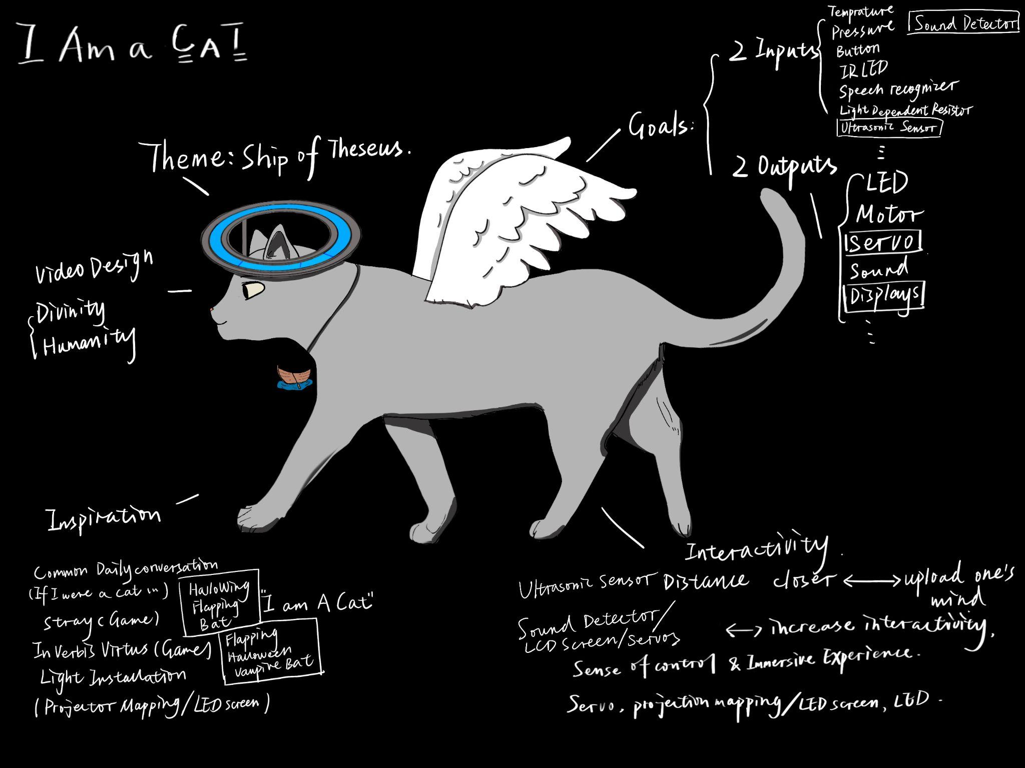
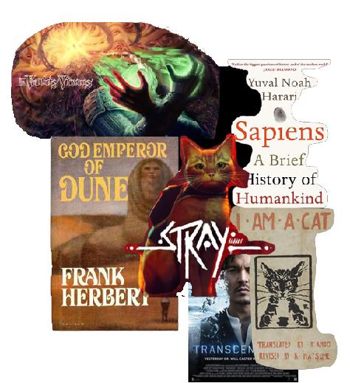
Inspiration
Concept: The theme of my project is the Ship of Theseus, which is a philosophical study of personal identity.
My inspiration originates from the daily conversation topic. When we see cats can do nothing but eating or sleeping, and they can relax in the sun while we are working, we can't help but say: I want to be a cat in my next life. My inspiration also comes from Natsume Soseki's I Am a Cat, because it’s a book written in the view of cat. The discussion on the human cyberization in the Brief History of Humankind also inspires me. Transcendence is also a movie about this question. Stray, a video game, where protagonist is a cat and there is also a scientist who uploaded his mind to robots. The game In Verbis Virtus gave me the inspiration of designing voice interaction.
Today, with the development of artificial intelligence, people have infinite fantasies about the future. People will imagine whether they can achieve immortality if their mind can be uploaded to the network or machine. They will also wonder if this is the same person as the original one after uploading?

Slide 3
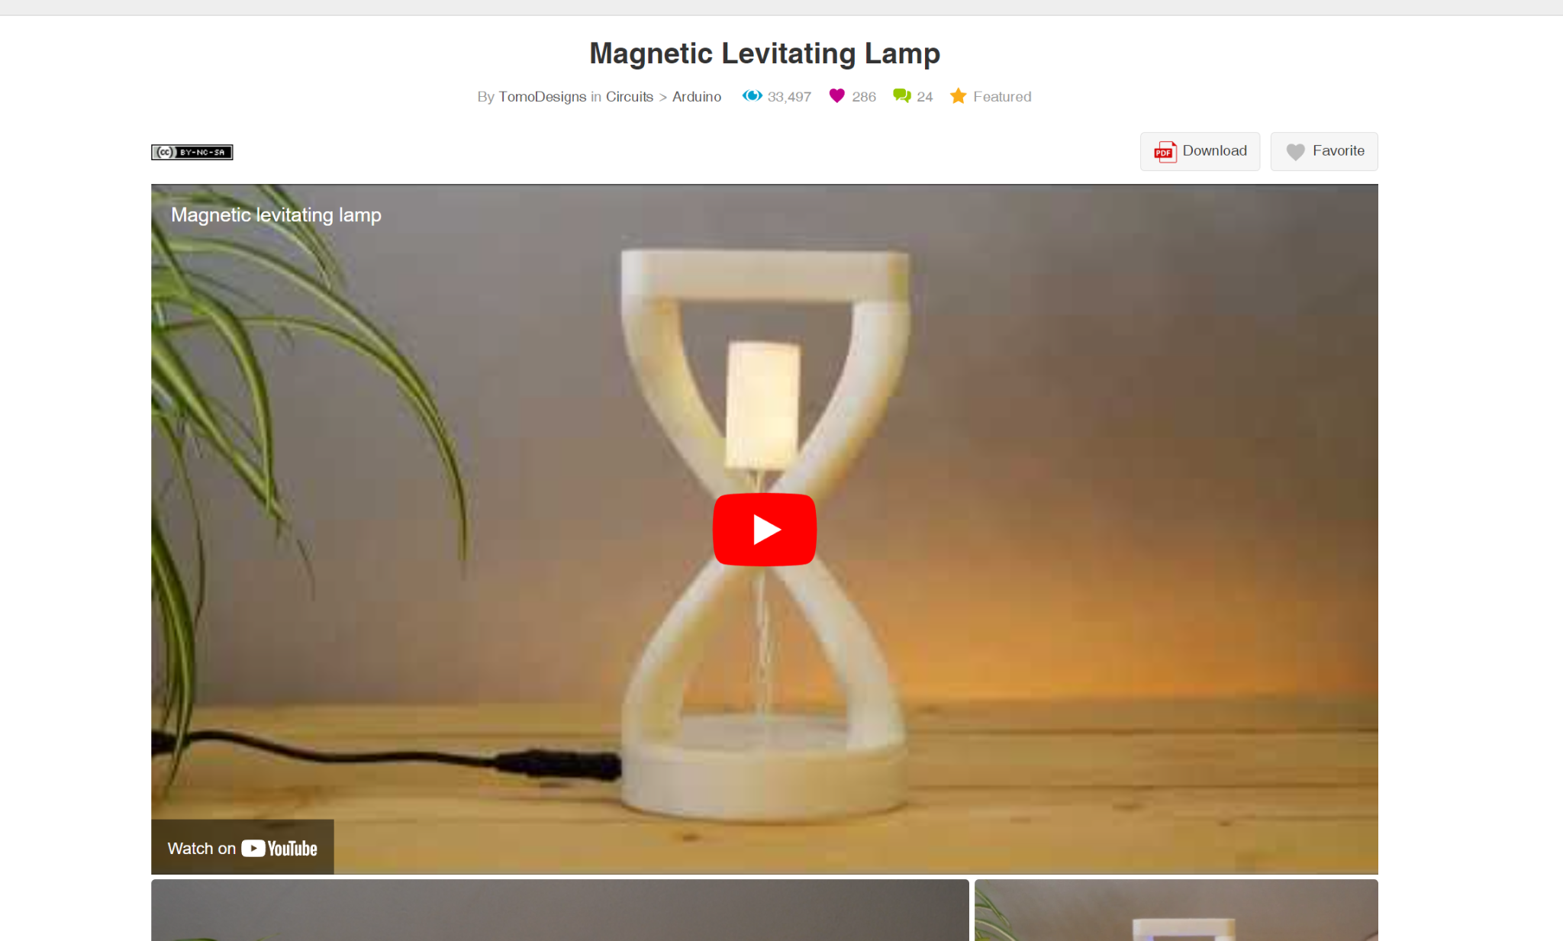
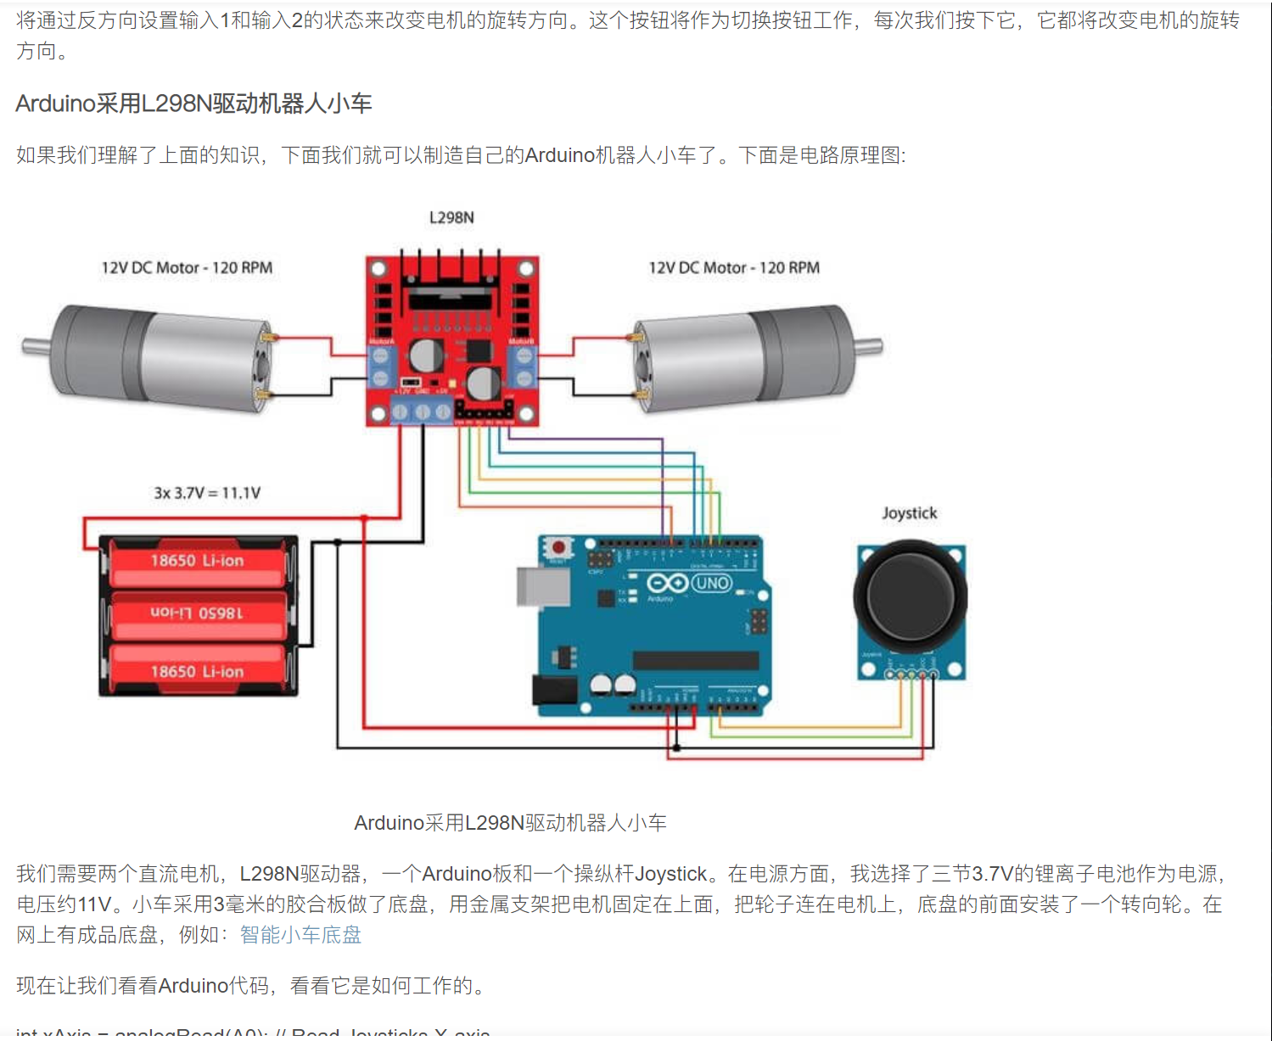
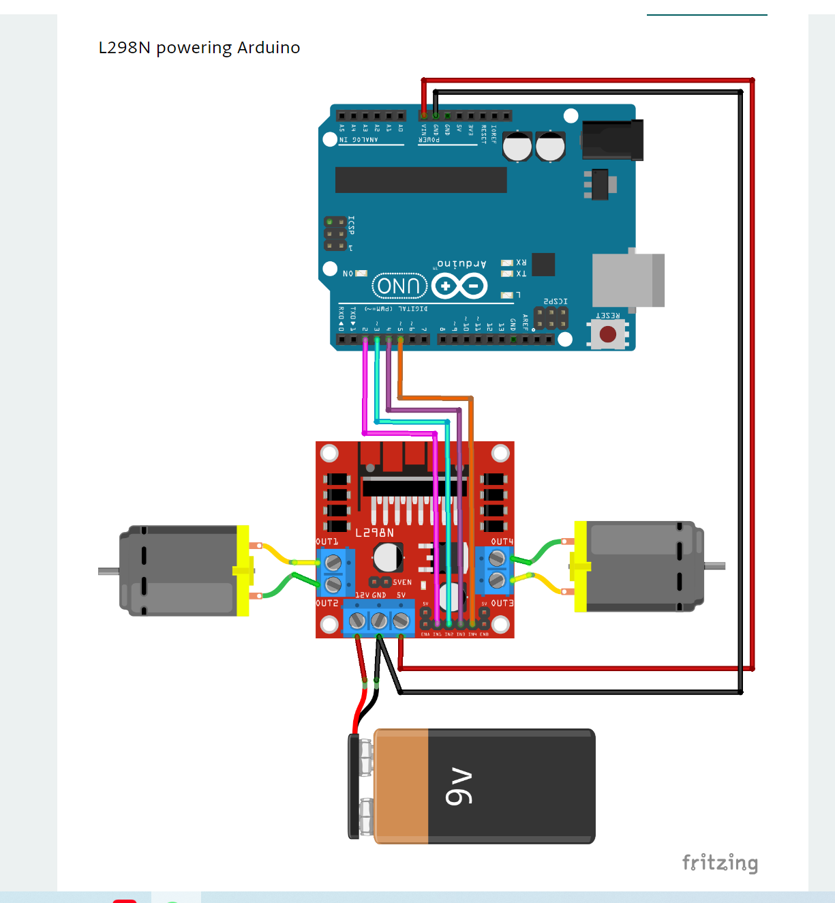
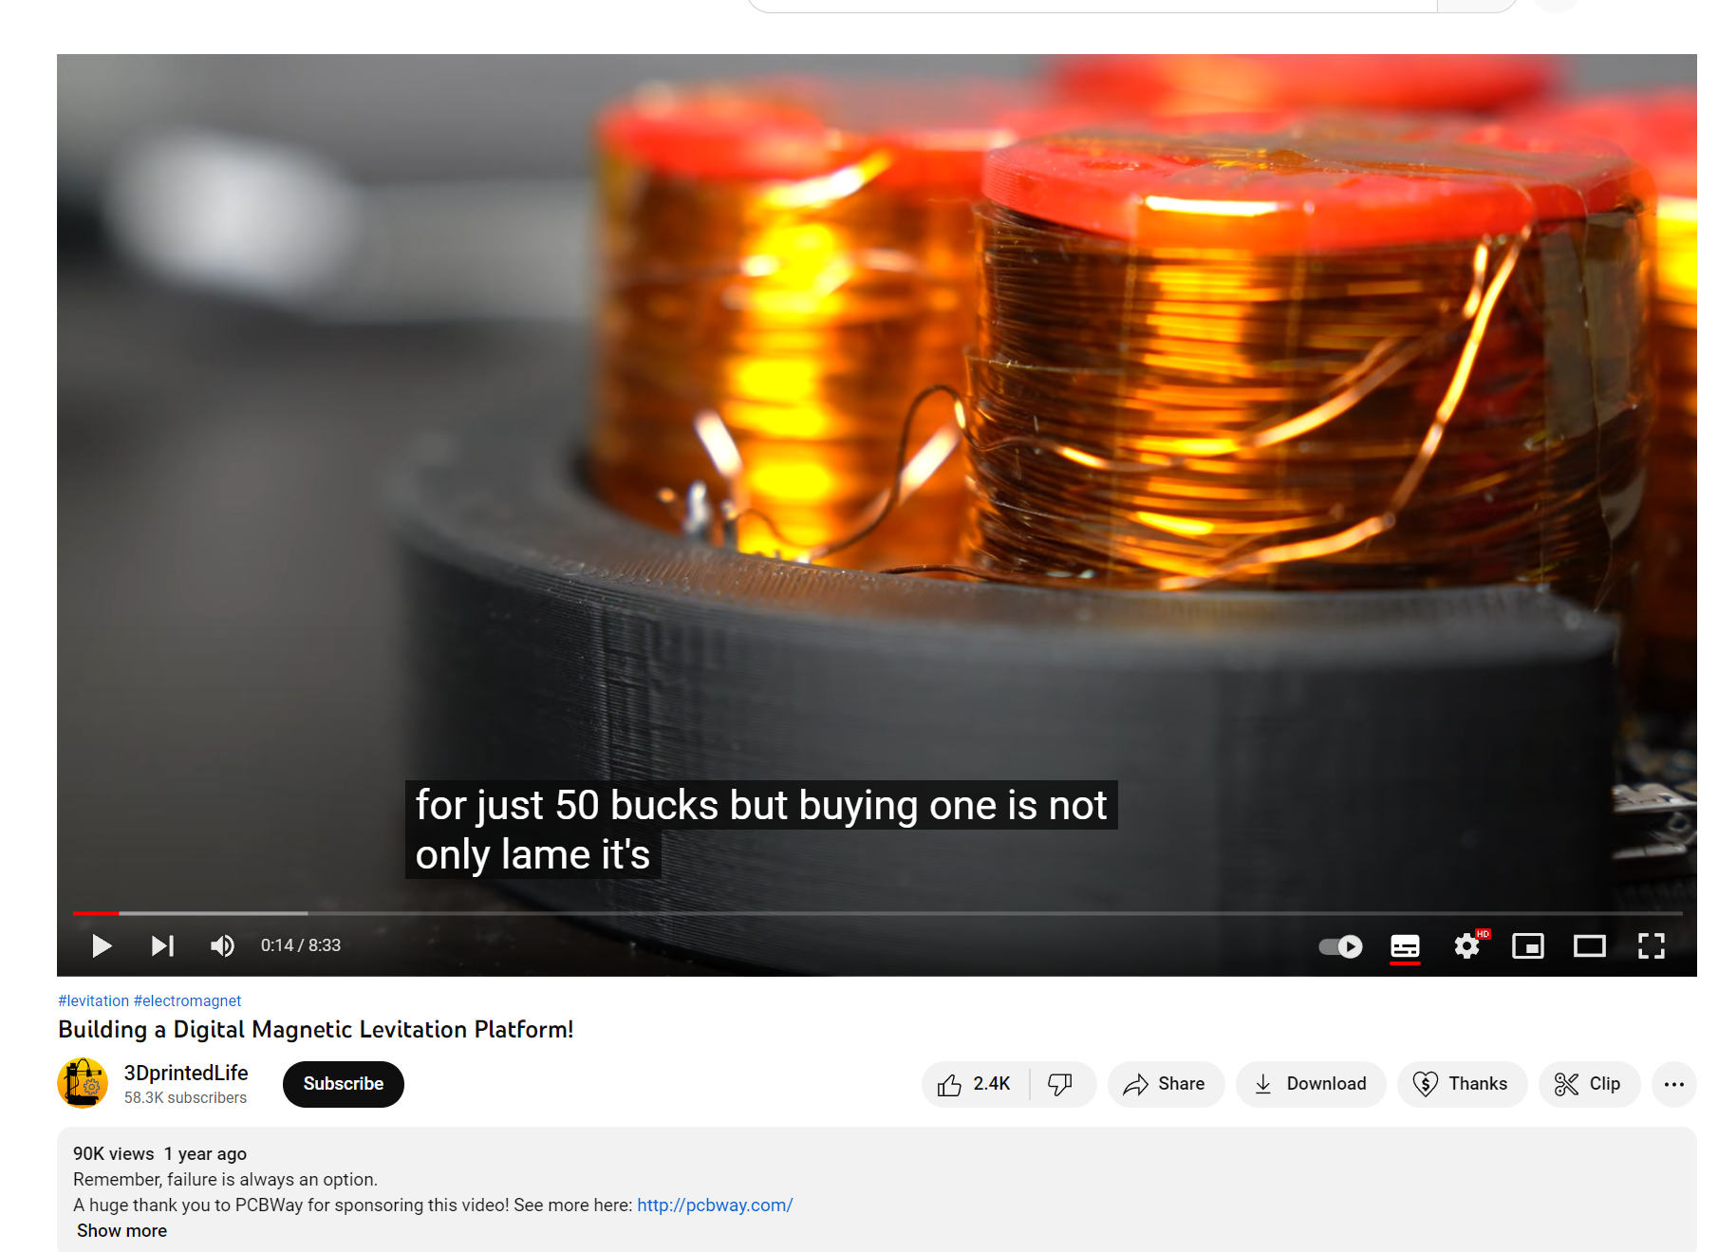
Challenges of Ideation
At the beginning, I want to use Magnetic Levitation. Later, I find that the push-up type is too large, and the upper-suction type need an extra installation containing magnet that can control the magnetic force on the cat's head. They are both complicated for me to do within a month when I am still working on another courses, so I give it up. I also think about making a cat device similar to an intelligent toy car. Although the survey results turn out that it is realizable, but because it is very common that almost every starters of mechanism would learn, I choose the current plan.

Slide 4
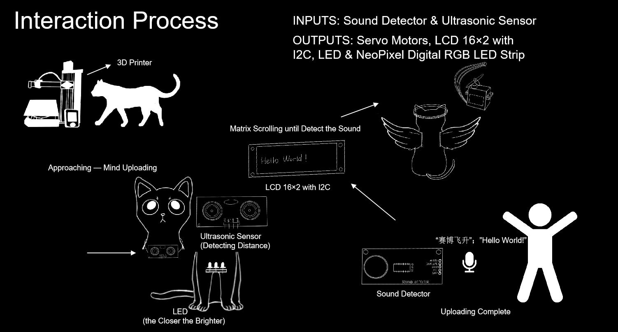
Sketch
I plan to print a cat model to contain Urduino Leronardo, perf and other components. Because I need to detect the distance, I plan to make the ultrasonic sensor a lacklace of the cat and insert the wires through the hole around the wings. When experiencers get closer, which is a process of uploading their mind, the LEDs will be brighter. When experiencers get close enough, they shout out “Hello World”, the sound detector will detect the sound and uploading process will be completed. The LCD will disaplay “hello world” the neo-pixel strip will light up and the wings will flap.

Slide 5
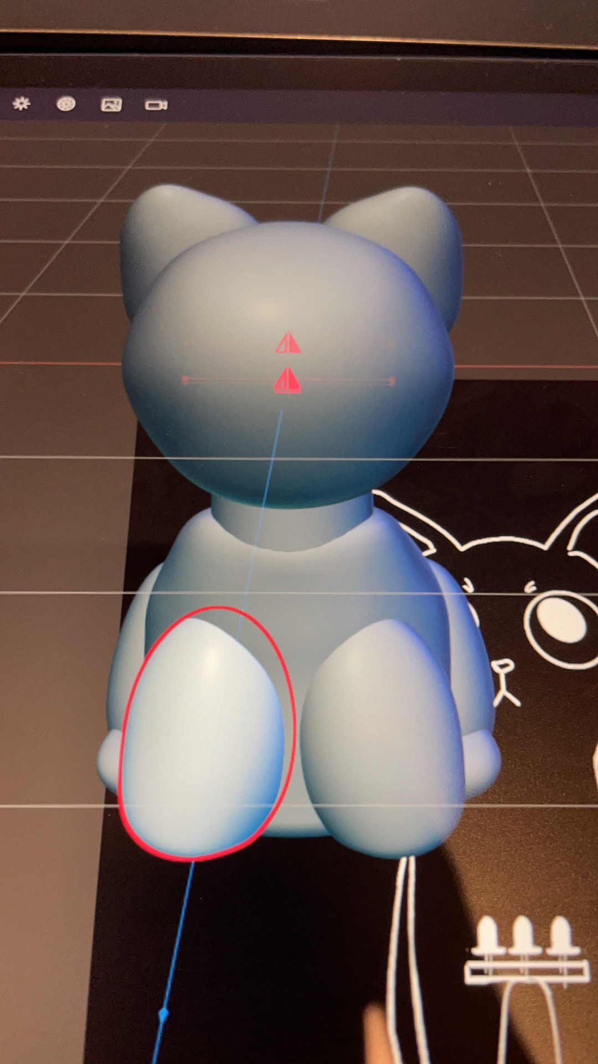
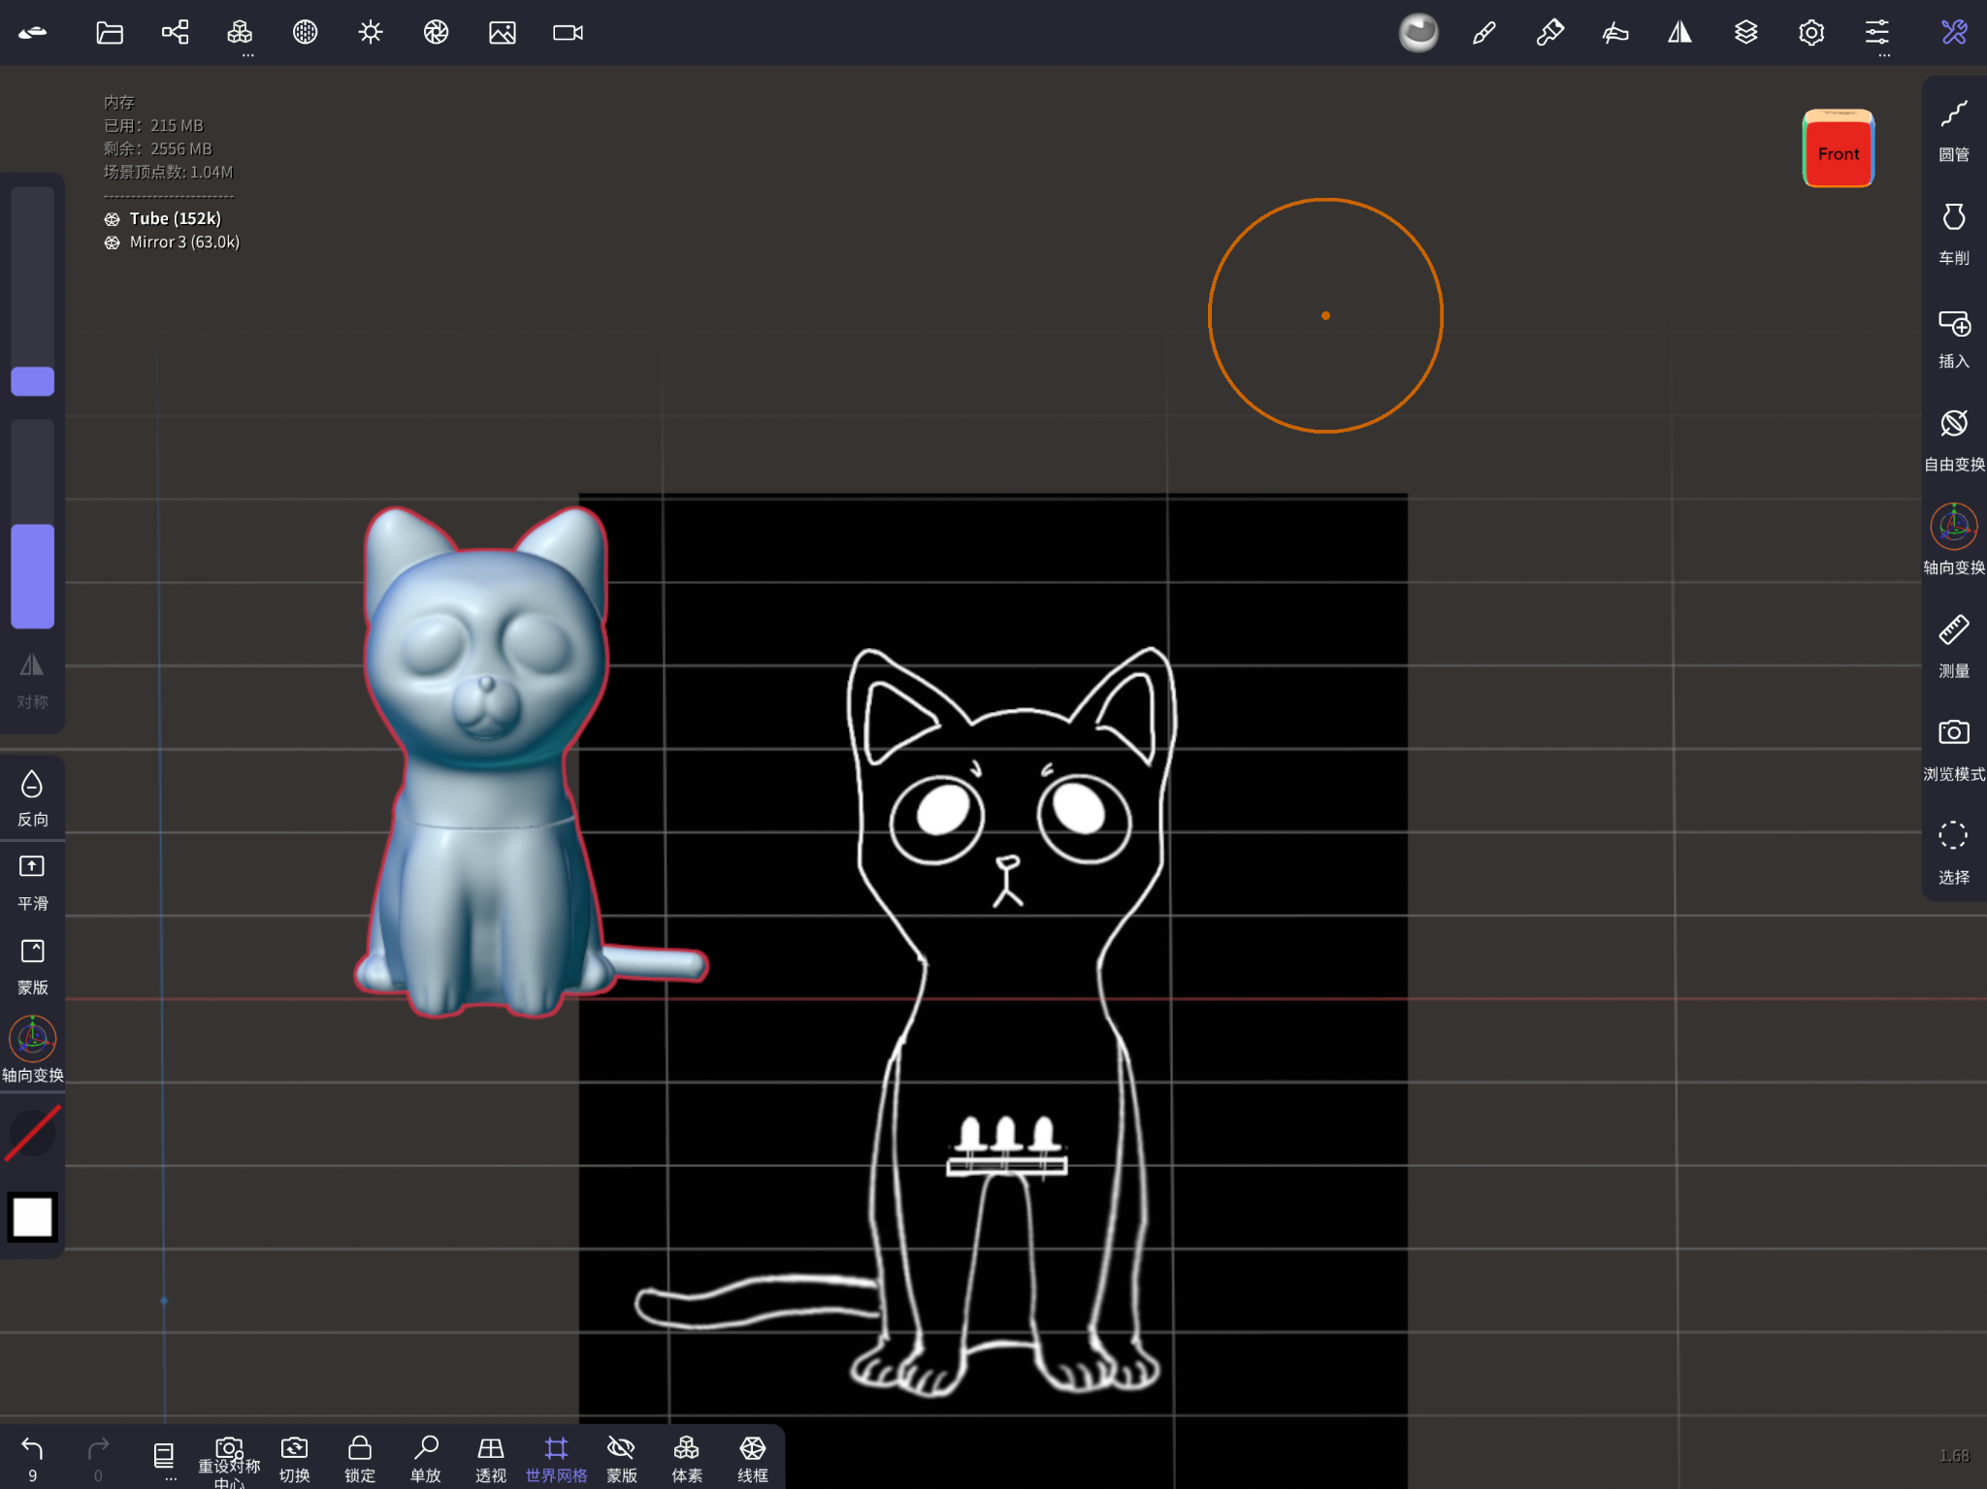
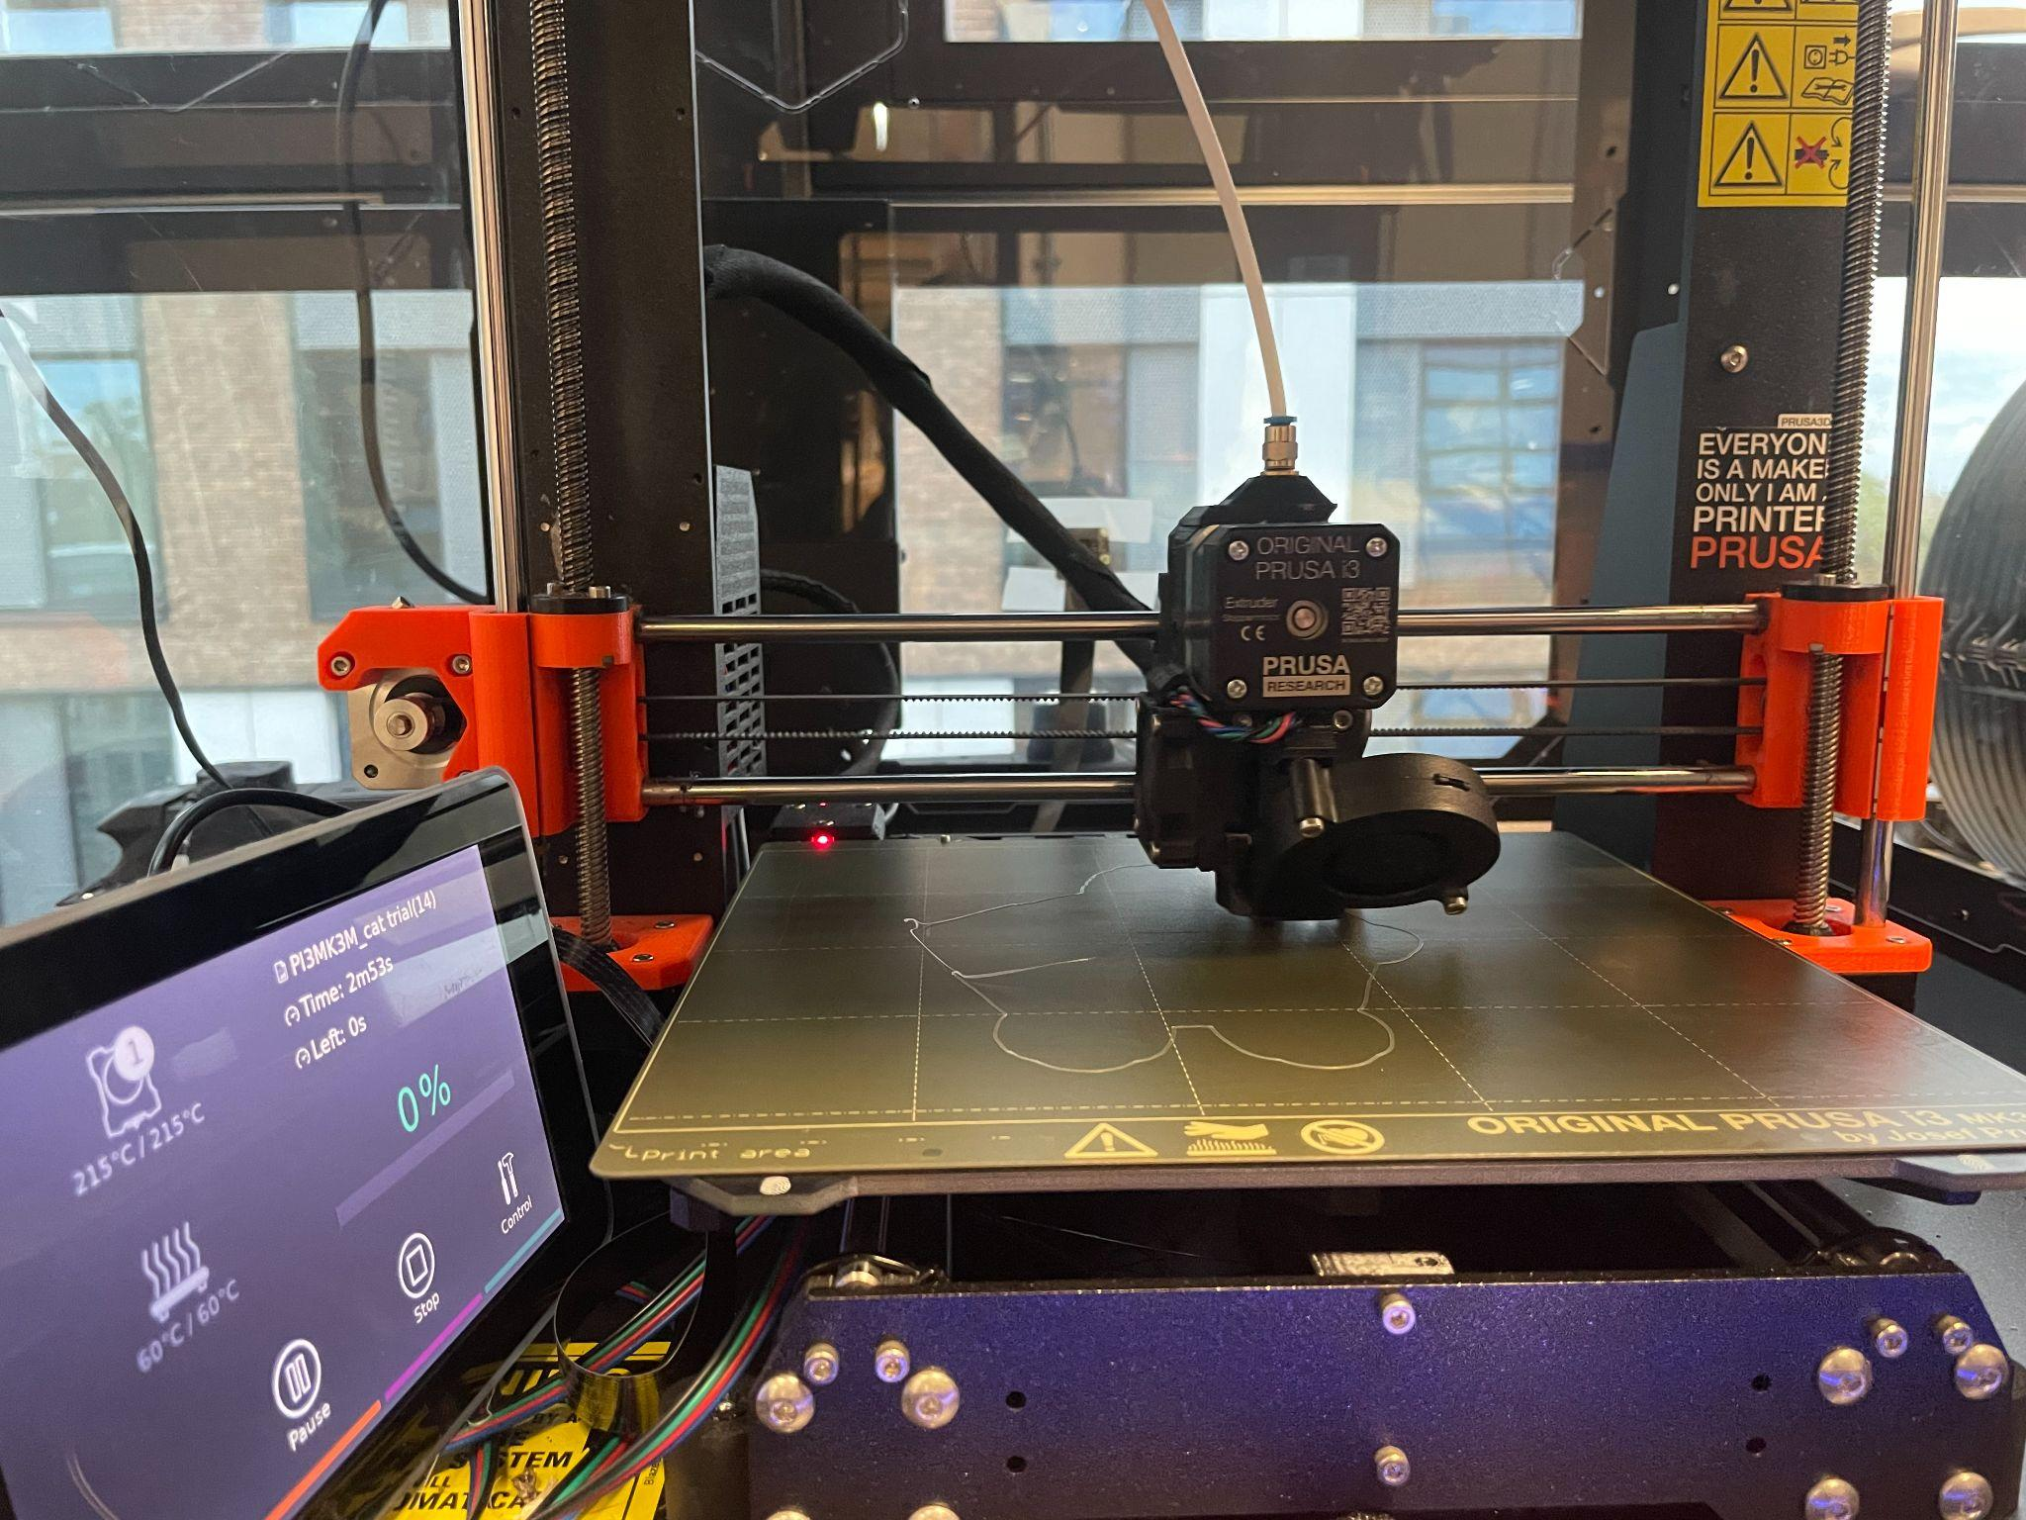
Challenges of 3D Printing
For the convenient and time limit, I decide to model my cat in Nomad, which is a sculpture software in the iPad. I’ve searched for some tips for creating 3d printing file. I learned to lower the poly count, key and split models for 3d printing, and trim a base for the model to stand. However, I "fight" with the 3d printer for almost a day and even adjust my model, but in the end it didn't work out. Hence, I intend to make a handmade cat shell out of cardboard. It seems to turn out pretty well now, the crafting reflects the loveliness of the painted cat compared to the loss of detail in the 3d print, and the wheels under the cat feet make it more mobile to take out and show off.

Slide 6
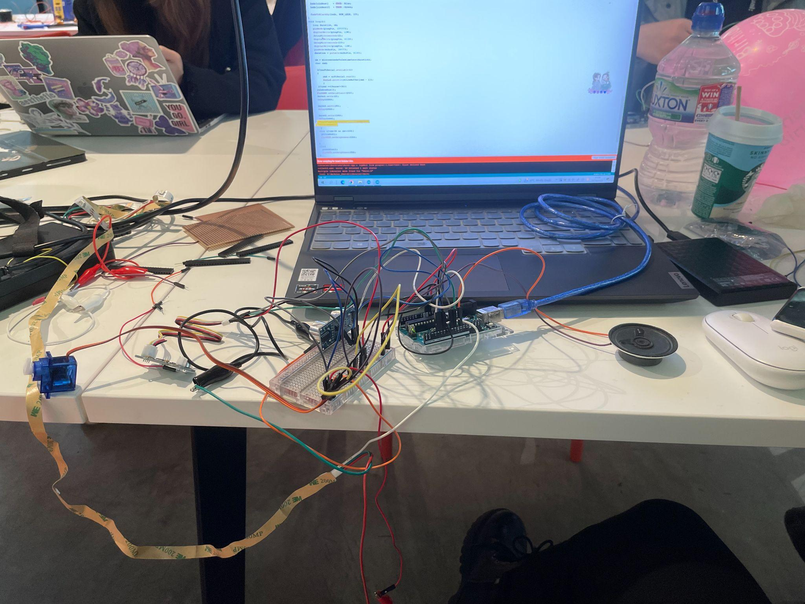
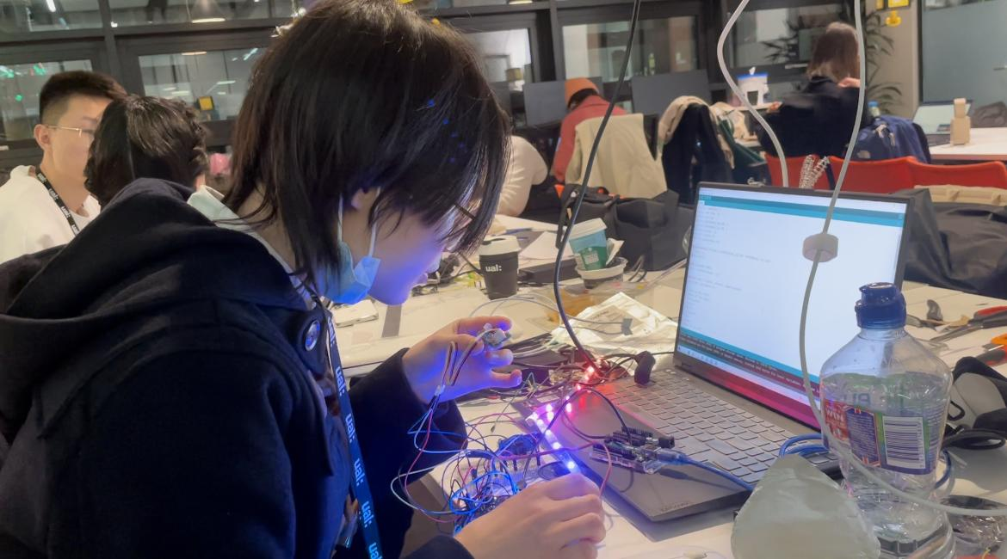
Challenges of Coding and Circuit
For the circuit, I separately test the ultrasonic sensor controlling neo-pixel stips and the speech recognizer controlling servo motor. For the neo-pixel part, I’ve studied fast_led and adafruit_neopixel library’s examples, encountered delay(); statement inapplicable issue and current direction problem. I’ve also tried to play audio without using MP3 trigger or DFPlayer. I try to use encode audio and pcm library, and figure out how to connect the trigger with leonardo board. However, after testing ,there are two problems prevent me from using the audio output — the sound of speaker is quite weird and the quality is low and the pcm library conflicts with the SoftwareSerial library, which is required by my neo-pixel strip.

Slide 7
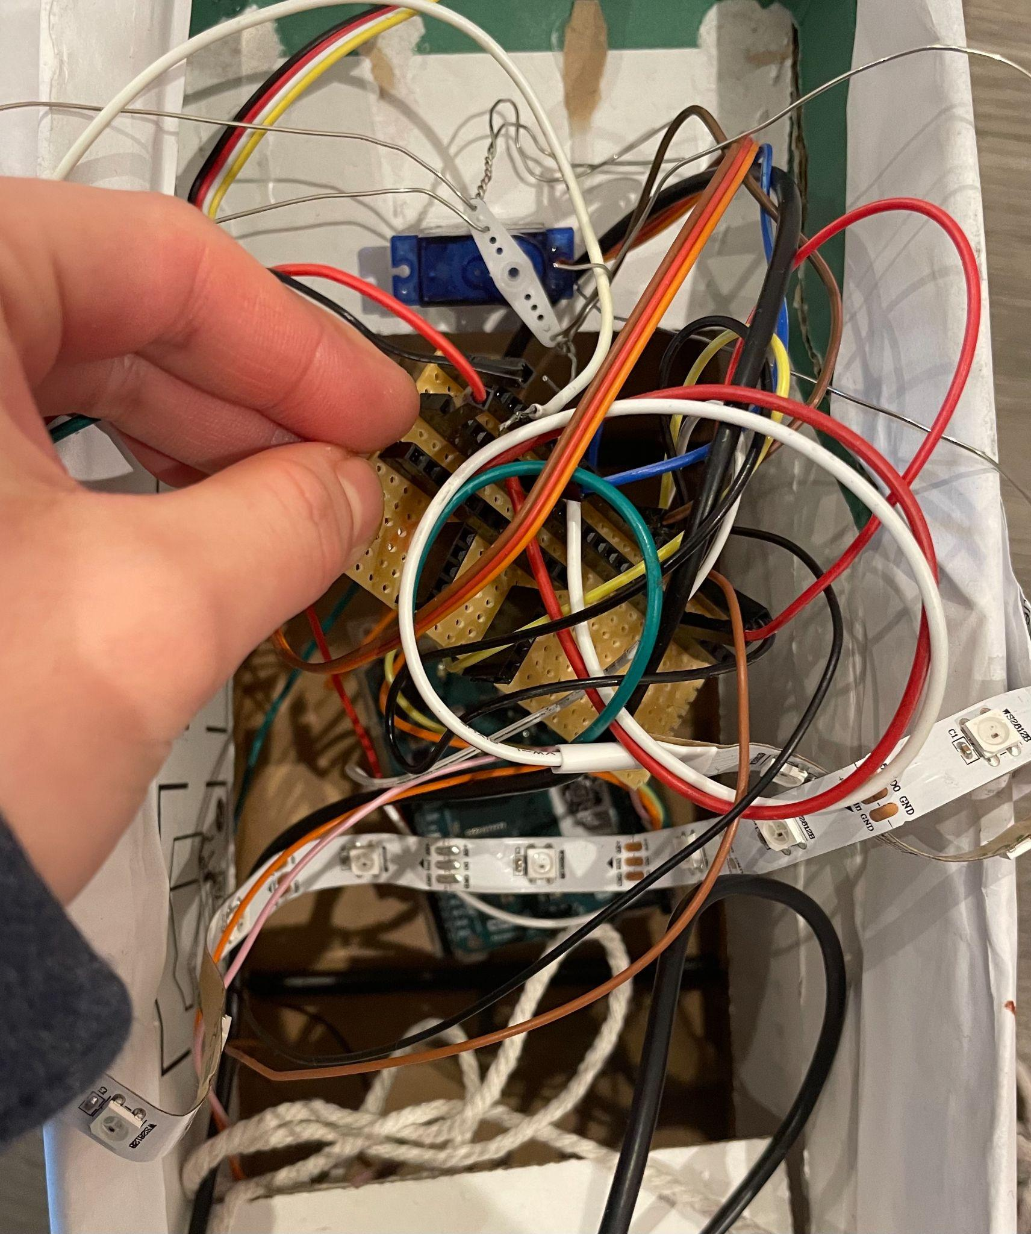
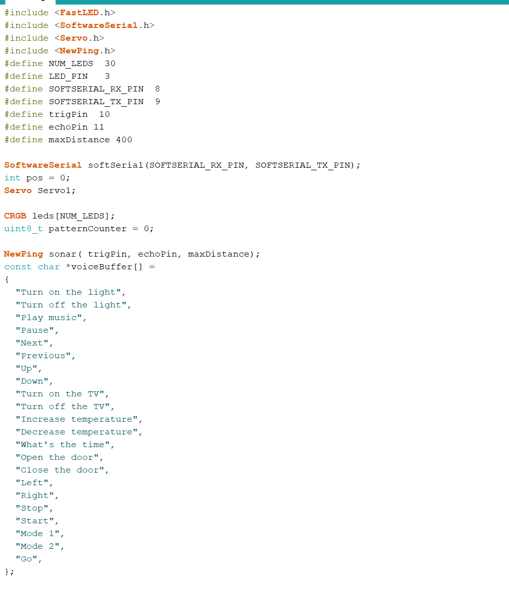
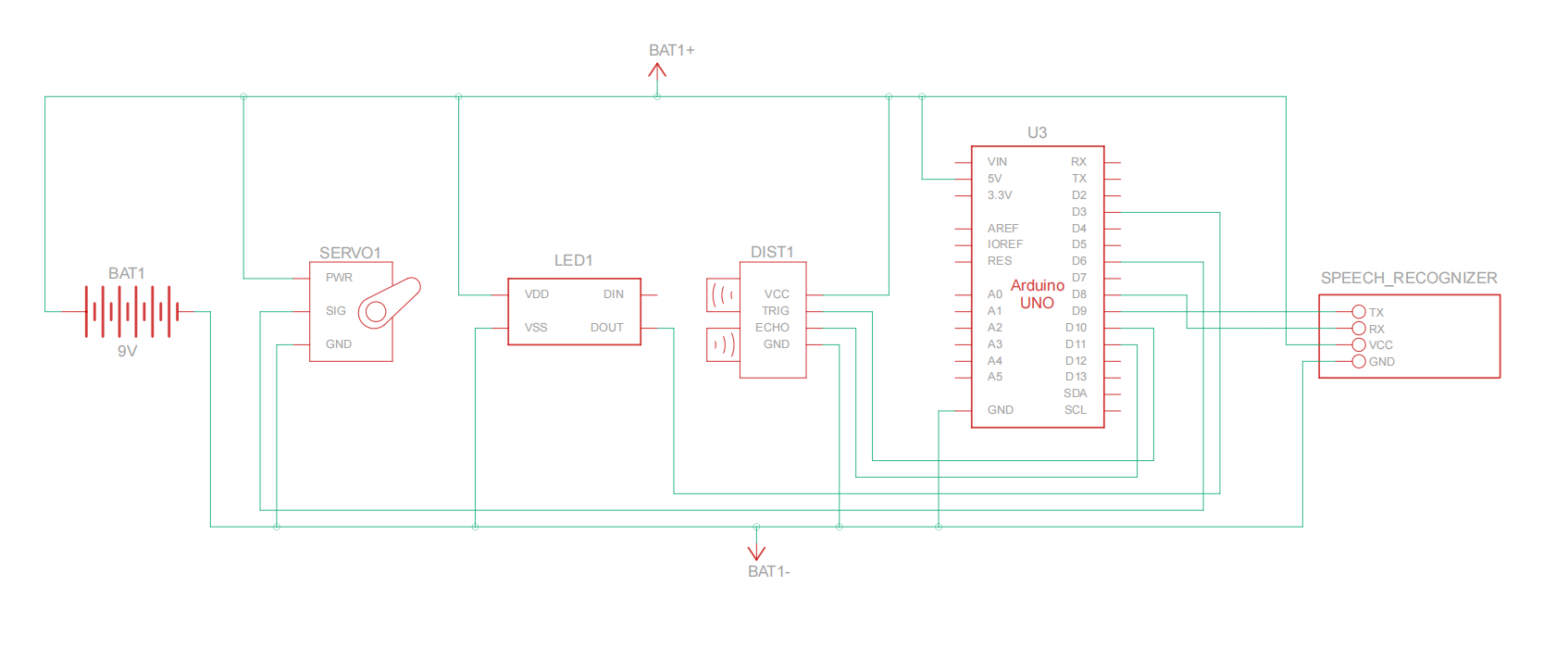
Circuit Diagram and Code
I use TinkerCad to make a draft of my schematic and upload to fusion 360 to edit. I only need to solder two straight PCB sockets on the perf that do not interfere with each other to connect the positive and negative poles of the power respectively. I glue the servo to the middle of the box with hot glue and pierce two holes in each wing. Then, I connect the wings to the servo with tin wire to move them. As there cannot be any block for the ultrasonic sensor, I solder its four pins with wire, and then glue it to the cat's neck with hot glue as a necklace.
For the final assembly part, code bugs, arduino board bugs, computer bugs, ide version bugs, soldering problems, and circuit problems, I have experienced all and solved one by one.

Slide 8
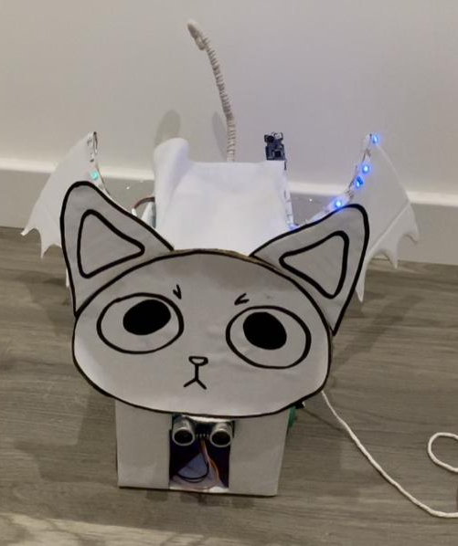
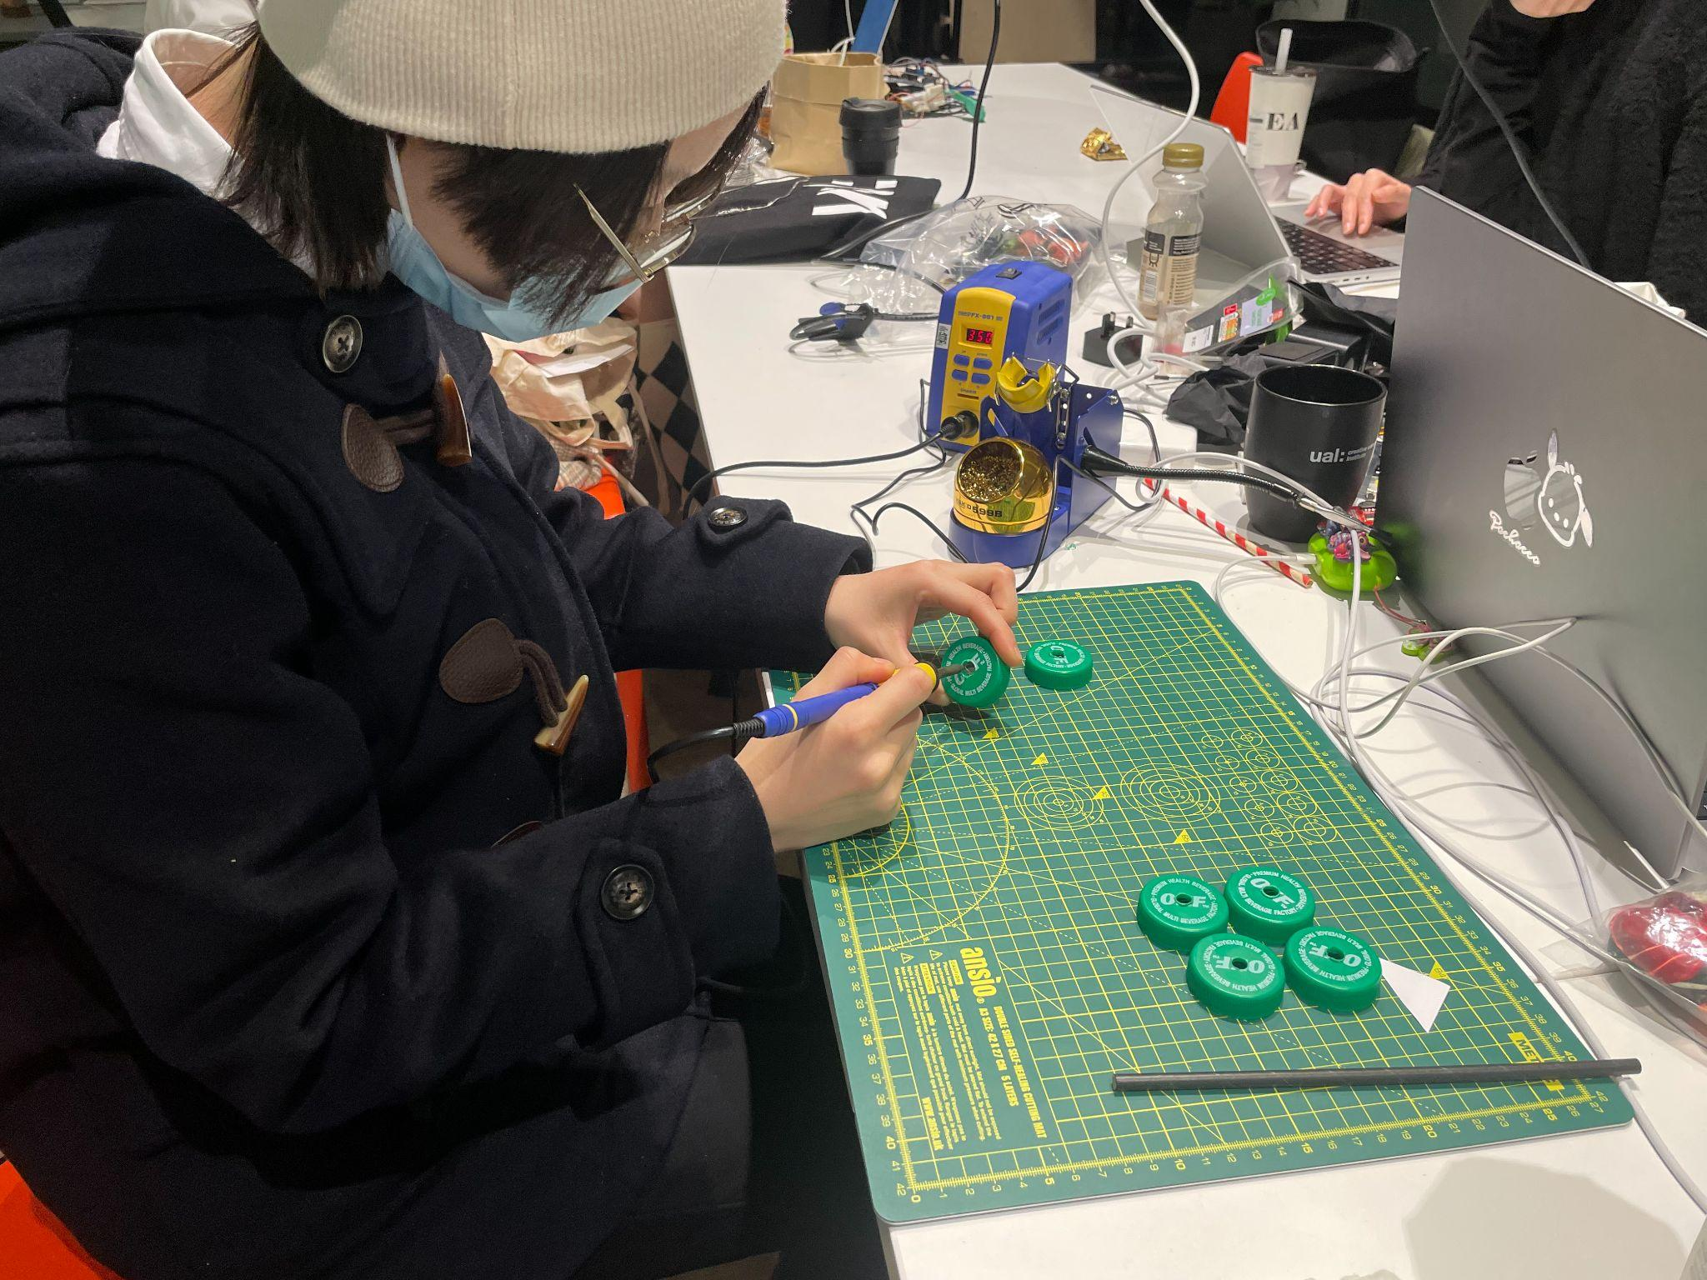
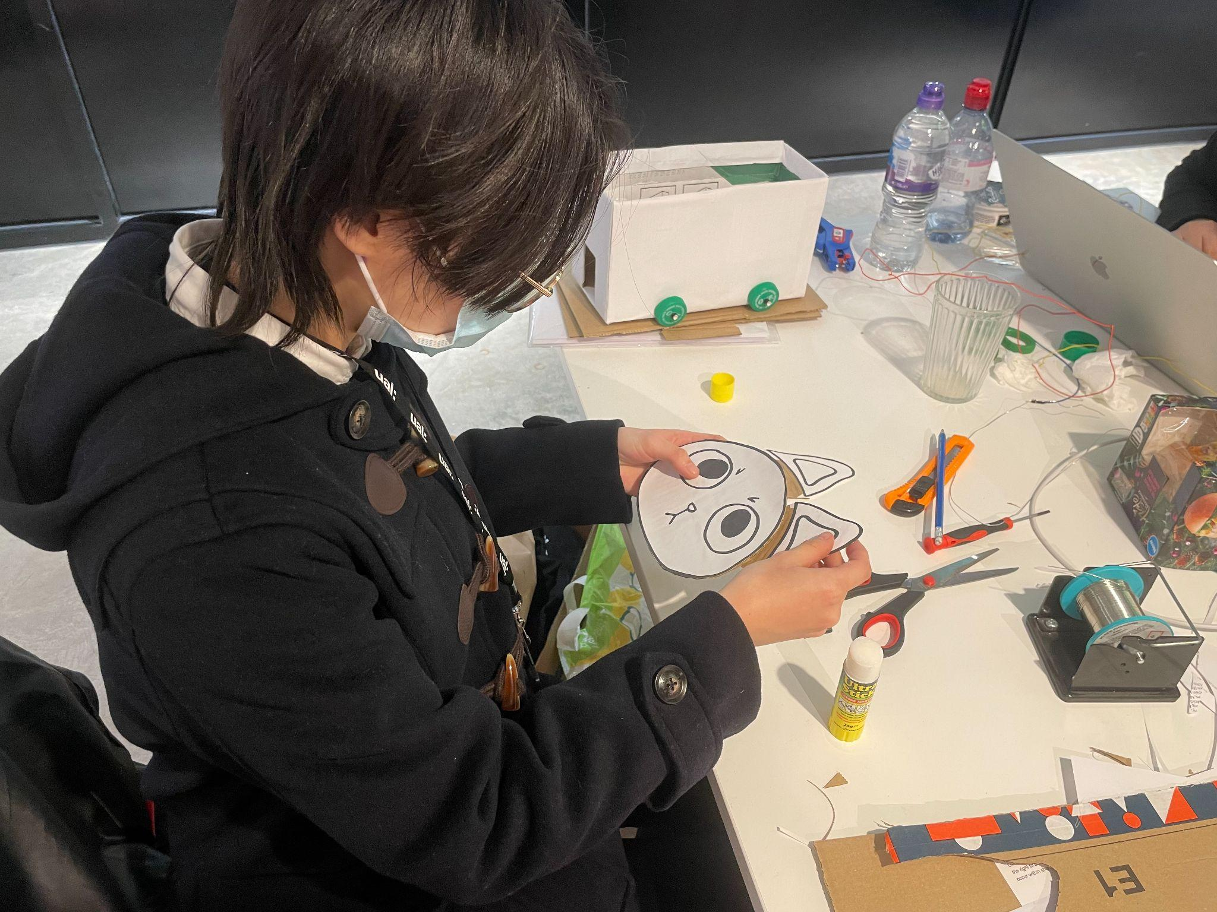
Housing
I have two discarded cardboard boxes and make one of two cardboard to be cat’s body. I use art knife to sculpture the feet. Because the cardboard box is too high for a cat, then I cut it off with scissors. The cat's head, ears, and wings are all copied from a design I drew at the end of the fourth week. I use scissors to poke four holes in the cardboard box bottom to assemble the wheels. I poke holes in each of the four caps with an electric solder iron and connect them with straws. A rubber band secure the ends to keep the wheels from slipping off.

Slide 9
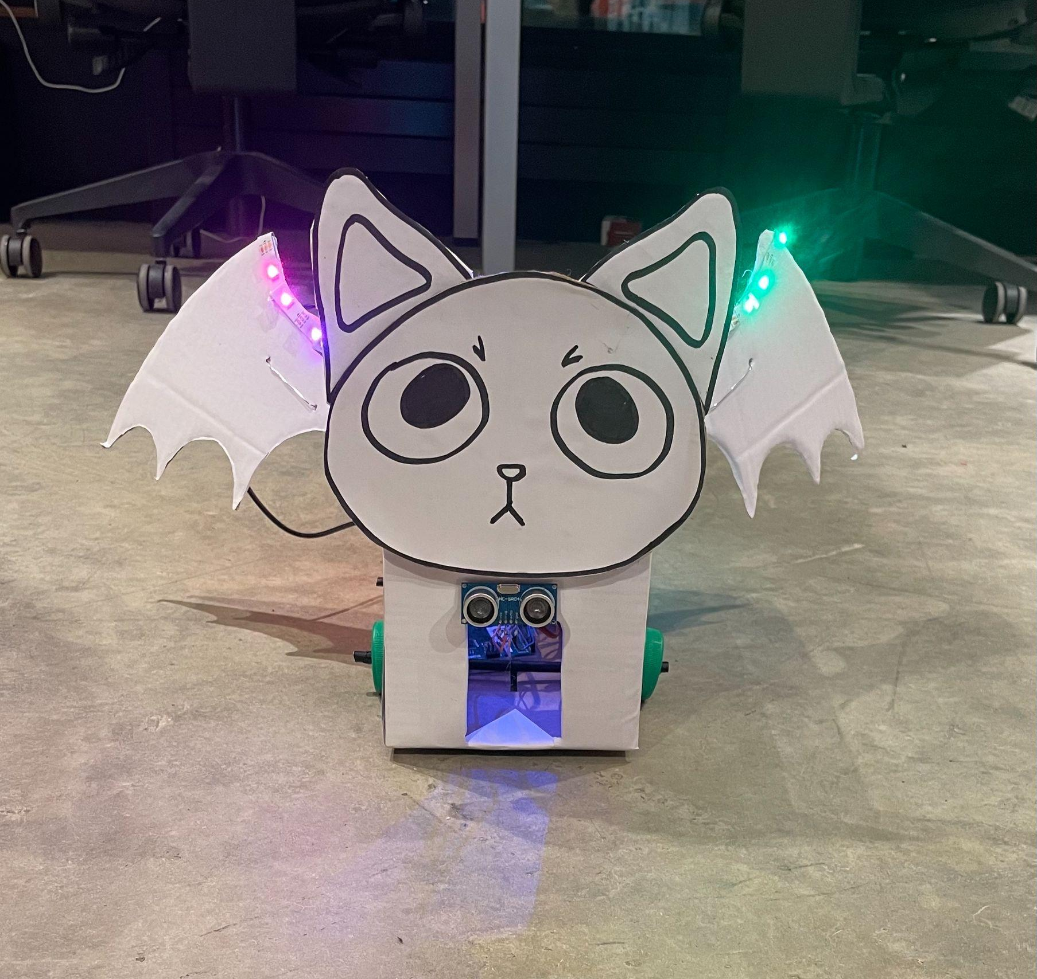
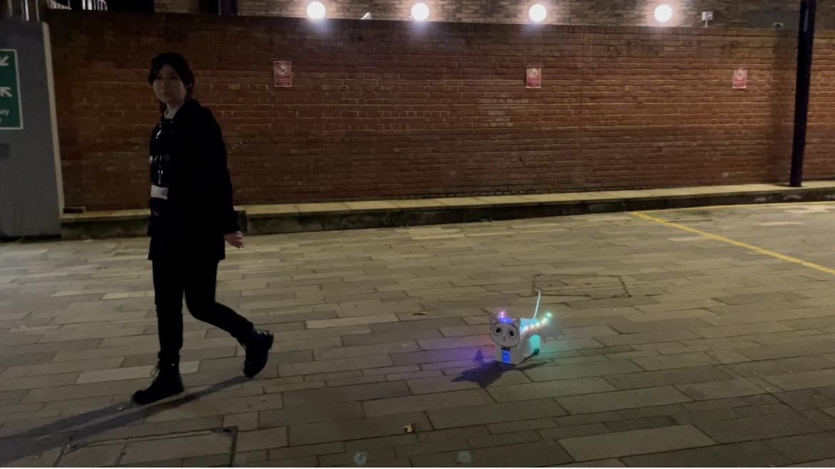
Result
When people get closer, which is a process of uploading their mind, the neo-pixel strip will change the light mode from blue green gradient, to red yellow gradient, to rainbow gradient. When people shout out: “Hi, Cell”, wait the red light turn up, and say: “start” , wait the blue light turn up, the servo will drive the wings to flip. Likewise, when people shout out: “Hi, Cell”, wait the red light turn up, and say: “stop”, wait the blue light turn up, the servo and the wings will all stop.

Slide 10
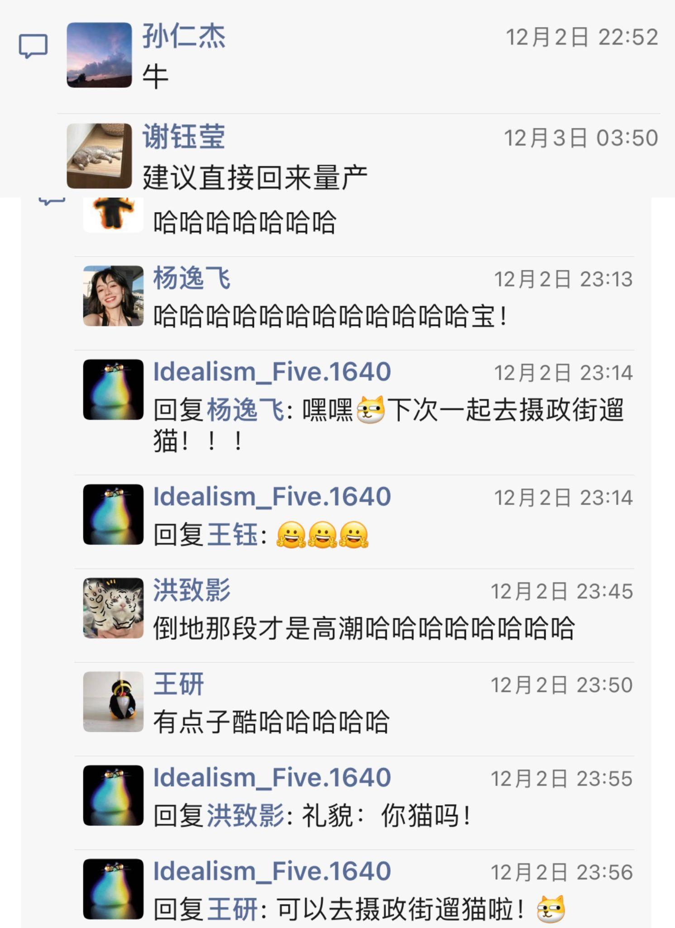
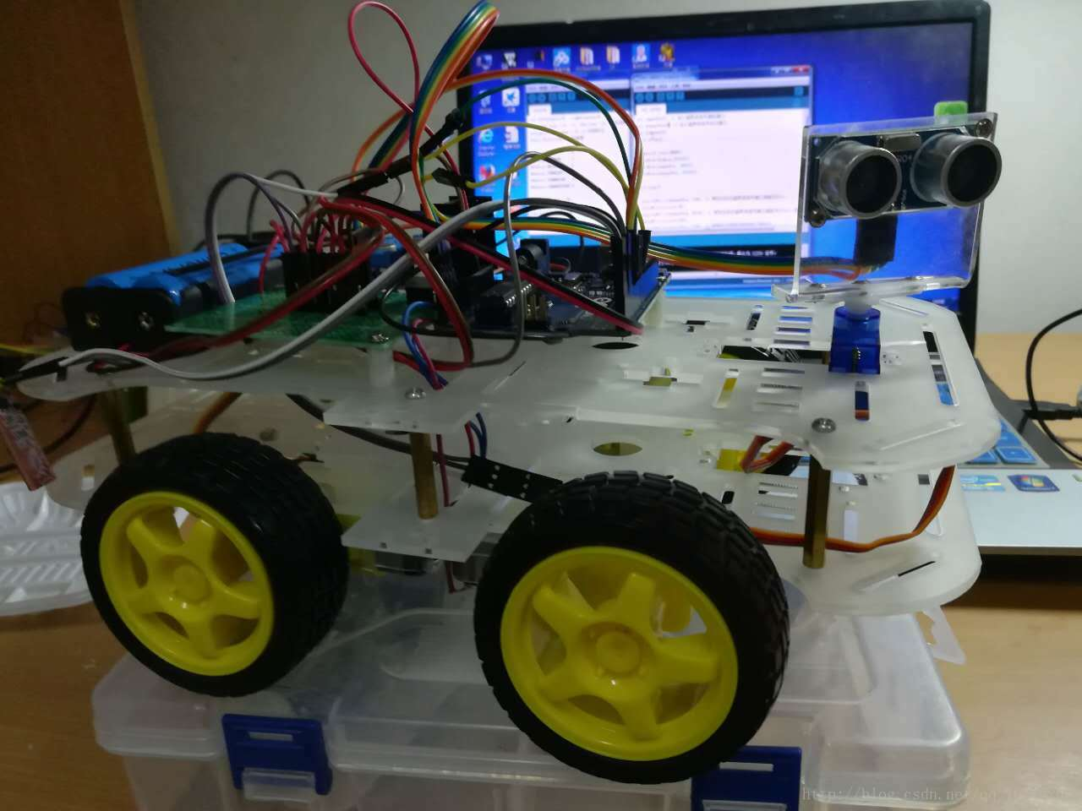
Future Possibility
After I finish this project, I post it on my WeChat Moment and it is widely praised by my friends. Many postgraduate and undergraduate students want me to mass-produce it and they are willing to take them out hanging out as AI pets. From that, I generate an idea for the future possibility of the project. I will try the LCD which has not been tested, and then try to use mp3 trigger or DFPlayer to trigger the audio, which will complete my unrealized idea before. In order to make the cat more intelligent, I will refer to the obstacle avoidance toy car, and make a cat shaped automatic driving toy car.

